Slide 1

Mini Project (KCA353) Odd Semester Session 2024-25
Project Supervisor:
Dr. Vipin Kumar
Associate Professor
Team Members:
Rashmi Mishra-2300290140137
Rashi Vishnoi-2300290140136
Ravi Singh-2300290140138
Ryan Goyal-2300290140151

Slide 2
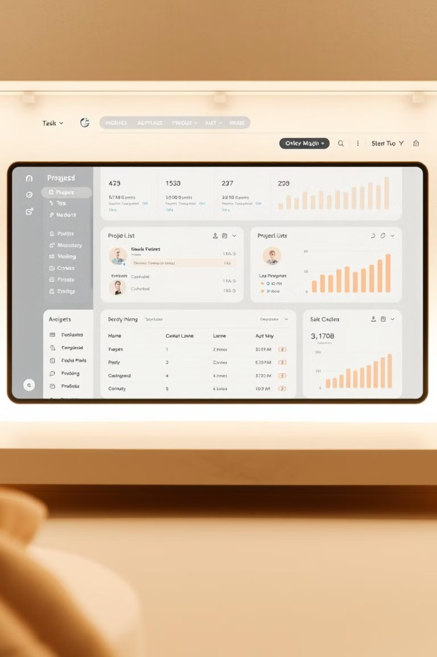
Project Hub: A Comprehensive Web Application
Project Hub is a web application designed to streamline project management, enhance collaboration, and foster efficient workflows. Project Hub aims to provide a central platform for all aspects of project development, from ideation to completion.

Slide 3

Objective of the Project
Project Hub aims to address the challenges of modern project management by providing a comprehensive, user-friendly platform that streamlines workflows, enhances collaboration, and facilitates effective communication.
Streamlined Workflows
Enhanced Collaboration
Effective Communication
Project Hub aims to simplify project workflows by providing tools for task management, scheduling, and progress tracking.
Project Hub encourages collaboration by enabling seamless communication, file sharing, and real-time updates.
Project Hub facilitates clear and efficient communication among team members, reducing misunderstandings and delays.

Slide 4
Technology
Project Hub leverages a combination of cutting-edge technologies to deliver a robust and scalable web application.
Front-end
Back-end
Database
React.js is utilized for the frontend development, offering a responsive and interactive user interface. Its component-based architecture ensures modularity and reusability.
Node.js with Express.js is used for the backend, providing efficient and scalable server-side logic. It utilizes a RESTful API for data communication.
MongoDB is used for the database, offering flexible and scalable data storage. It provides a document-oriented structure for efficient data retrieval and manipulation.
Authentication
Image Management
JWT, or JSON Web Token, is a compact, URL-safe means of representing claims to be transferred between two parties. It's commonly used for authentication and information exchange in web applications.
Cloudinary is a cloud-based platform that provides a comprehensive suite of tools for managing, transforming, optimizing, and delivering images and videos.

Slide 5

Hardware Requirements
The development environment requires a suitable hardware setup to ensure efficient performance and smooth workflow.
Requirement
Description
Development Environment
A modern laptop or desktop computer with a processor capable of handling intensive development tasks.
Server Requirement
If deploying a server-side application, a dedicated server with sufficient RAM, CPU, and storage is necessary. Cloud-based hosting services are also available.
Client Requirement
The client-side application is designed to run on a variety of devices, including desktop computers, laptops, tablets, and smartphones. A reliable internet connection is necessary.

Slide 6
Software Requirements
Project Hub requires a set of essential software tools and technologies to ensure successful development and deployment.
Development Tools
Languages and Platforms
Visual Studio Code (VS Code)
Git
Figma
JavaScript (Node.js, React.js, Express.js)
HTML
CSS
MongoDB (NoSQL database)

Slide 7
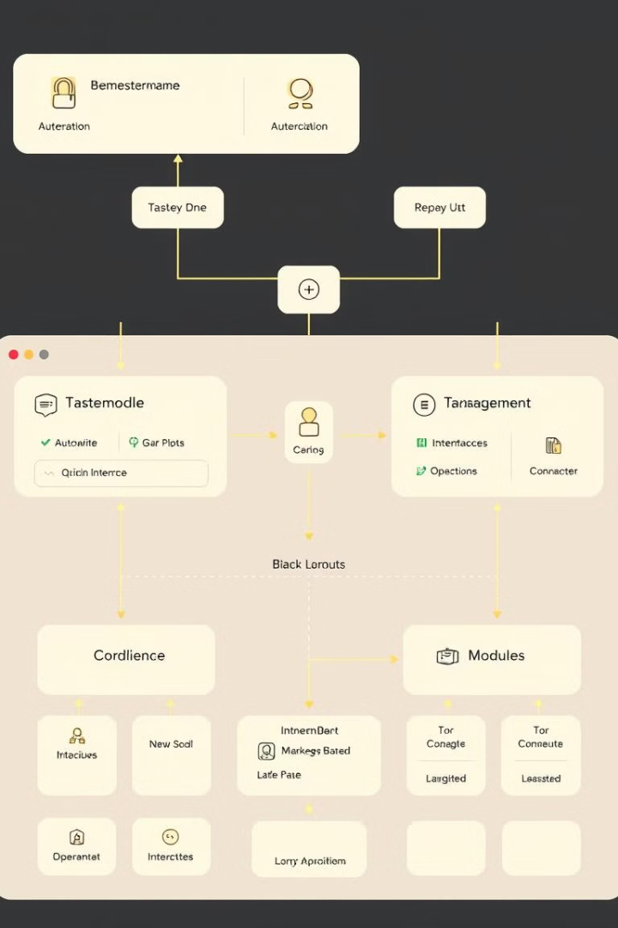
Modules
Project Hub is divided into distinct modules to ensure efficient development, maintenance, and scalability.
1
User Authentication
2
Project Management
The user authentication module handles user registration, login, and session management.
The project management module provides functionalities for creating projects, assigning tasks, tracking progress, and managing deadlines.
3
Collaboration Tools
The collaboration tools module enables communication, file sharing, and real-time updates among team members.

Slide 8
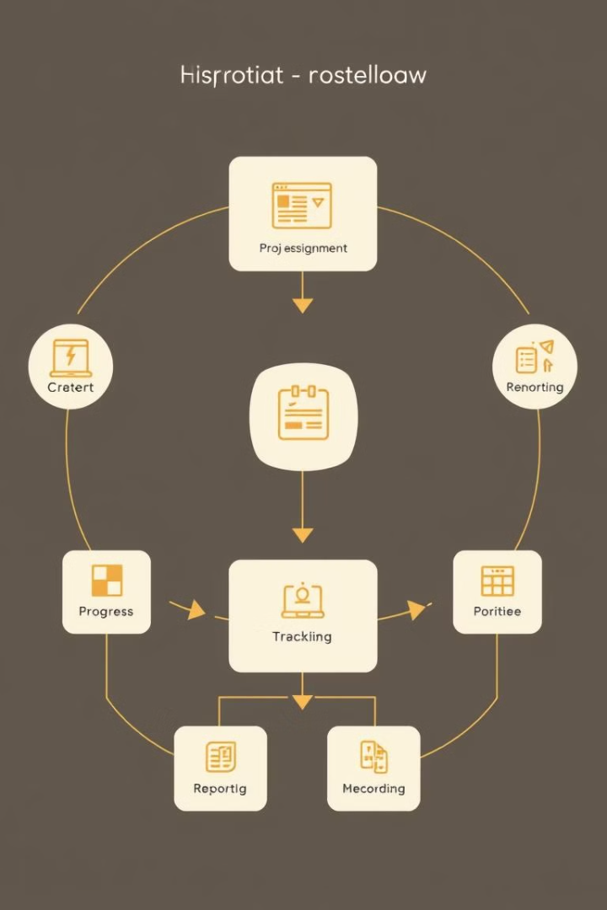
Modules
Project Hub is divided into distinct modules to ensure efficient development, maintenance, and scalability.
1
Data Management
2
User Interface (UI)
The data management module handles data storage, retrieval, and manipulation, ensuring data integrity and security.
The UI module focuses on creating a user-friendly and intuitive interface, enhancing user experience.
3
API
The API module provides a set of endpoints for communication between the frontend and backend, ensuring seamless data exchange.

Slide 9




Conclusion
Project Hub is a powerful web application designed to streamline project management, enhance collaboration, and foster efficient workflows.
User-Friendly
Efficient
Project Hub features a user-friendly interface, making it easy for users to navigate and utilize the various functionalities.
Project Hub streamlines project management processes, improving efficiency and productivity.
Collaborative
Project Hub fosters collaboration among team members, facilitating seamless communication and knowledge sharing.

Slide 10
References
npm on W3Schools: W3Schools npm Tutorial - A comprehensive guide to managing packages on Node.js and JavaScript using npm.
Node.js on GeeksforGeeks: GeeksforGeeks Node.js Compiler - An online compiler to practice Node.js coding.
MongoDB Documentation: MongoDB Official Documentation - Official documentation for MongoDB, including guides, tutorials, and manuals.
Udemy Course by Angela Yu: A comprehensive course by Dr. Angela Yu that covers HTML, CSS, JavaScript, Node.js, React, and more.

